Slide 1
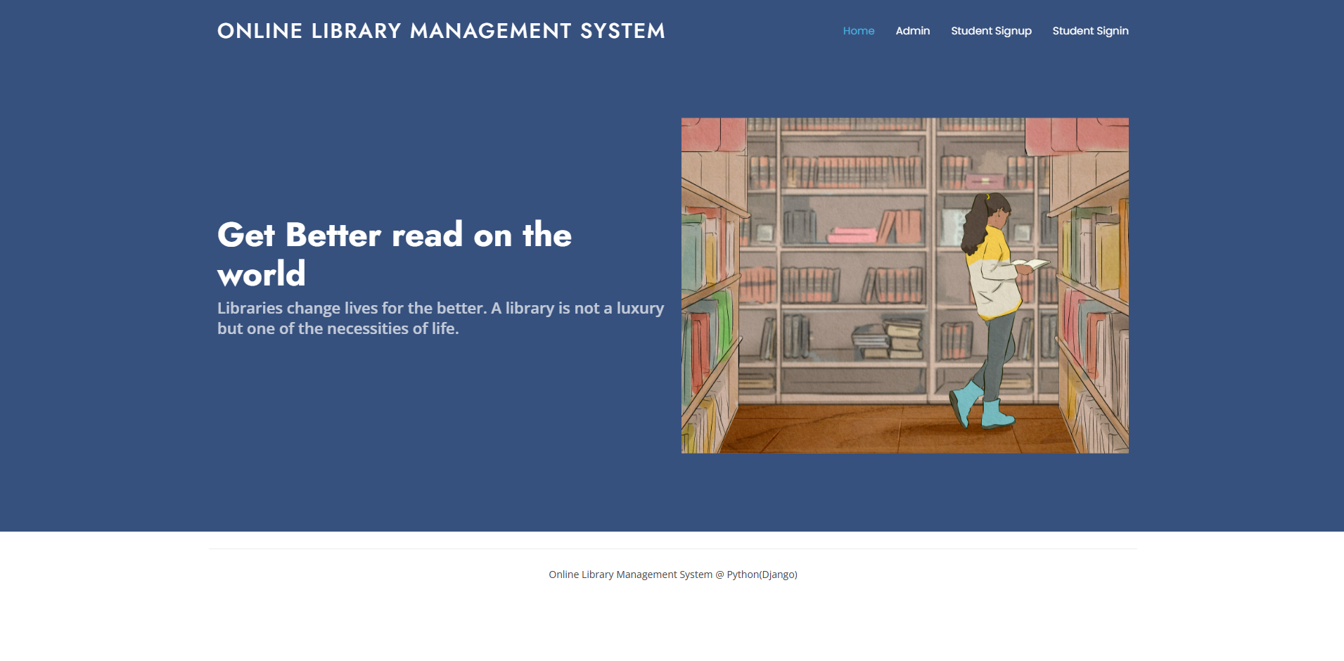
Online Library Management System
Major Project Presentation by- Akshat Gangrade and Jeet Singh Bais

Slide 2
Overview
To build a library management which contains two login :- student and admin(librarian).
There will be various features like
Searching of books
Issuing and returning books
Librarian can read information about any member
Librarian can track the books issued by a particular student

Slide 3
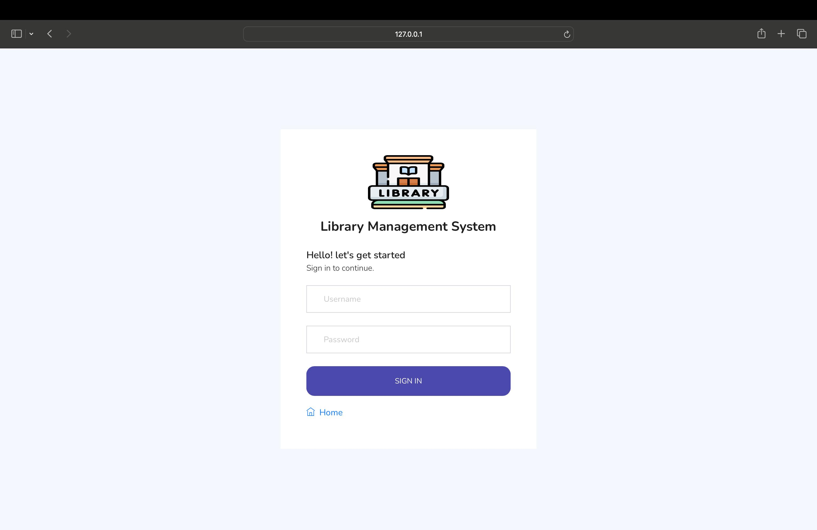
Module 1 - Student Login / Admin Login
Authentication of the user will be there.
Username and password will be matched from our database. Once both username and password matches, then only a user is allowed to enter into the system.
Similarly for admin there will be a authentication system.

Slide 4
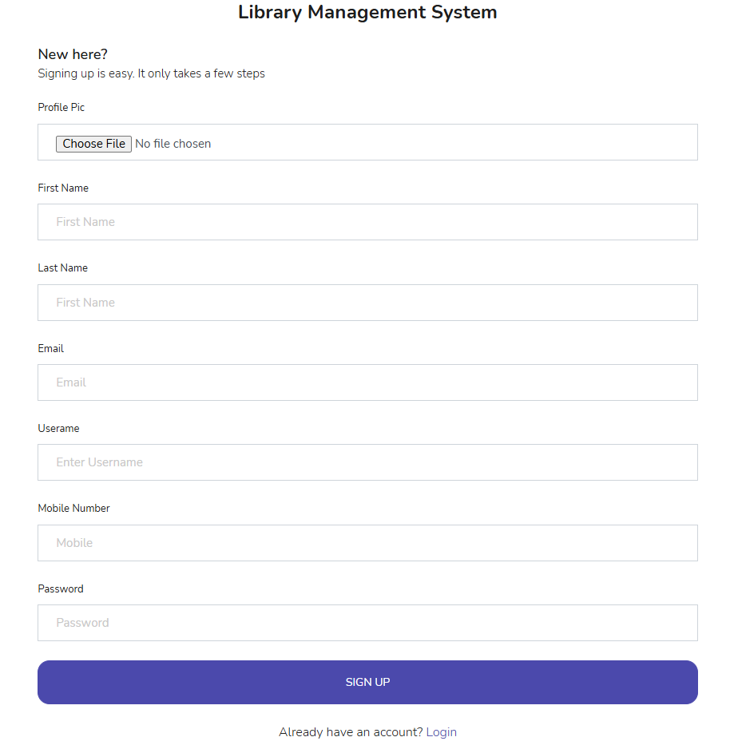
Module 2 - Signup For New Uses
For new users there will be sign up option
Various details like registration number , username , password etc. will be taken from the user and then it will be updated in our database.
After this , the user will be redirected to the login page.

Slide 5
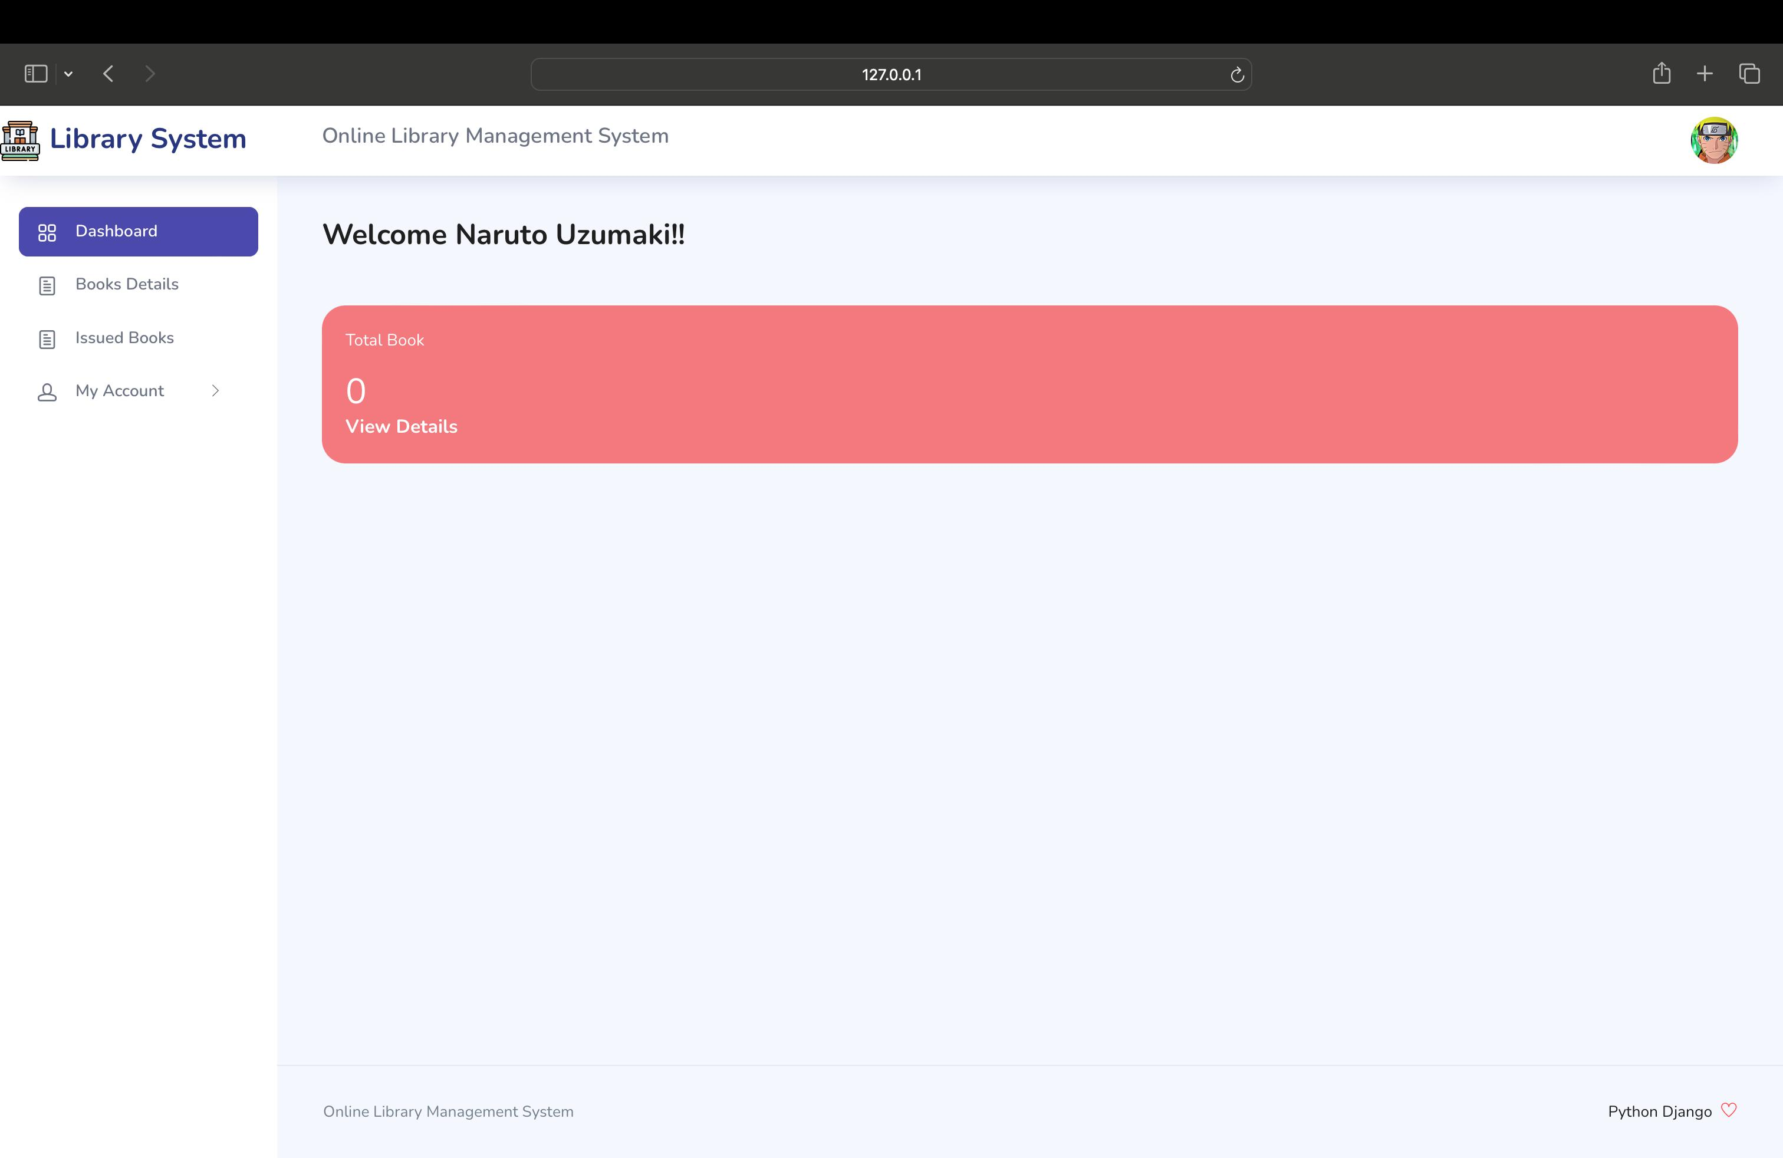
Module 3 - Student Profile
After successful login into system, user can see its details
Various details which will be shown are:-
Issued books
Date of issue
Searching book in the library.

Slide 6
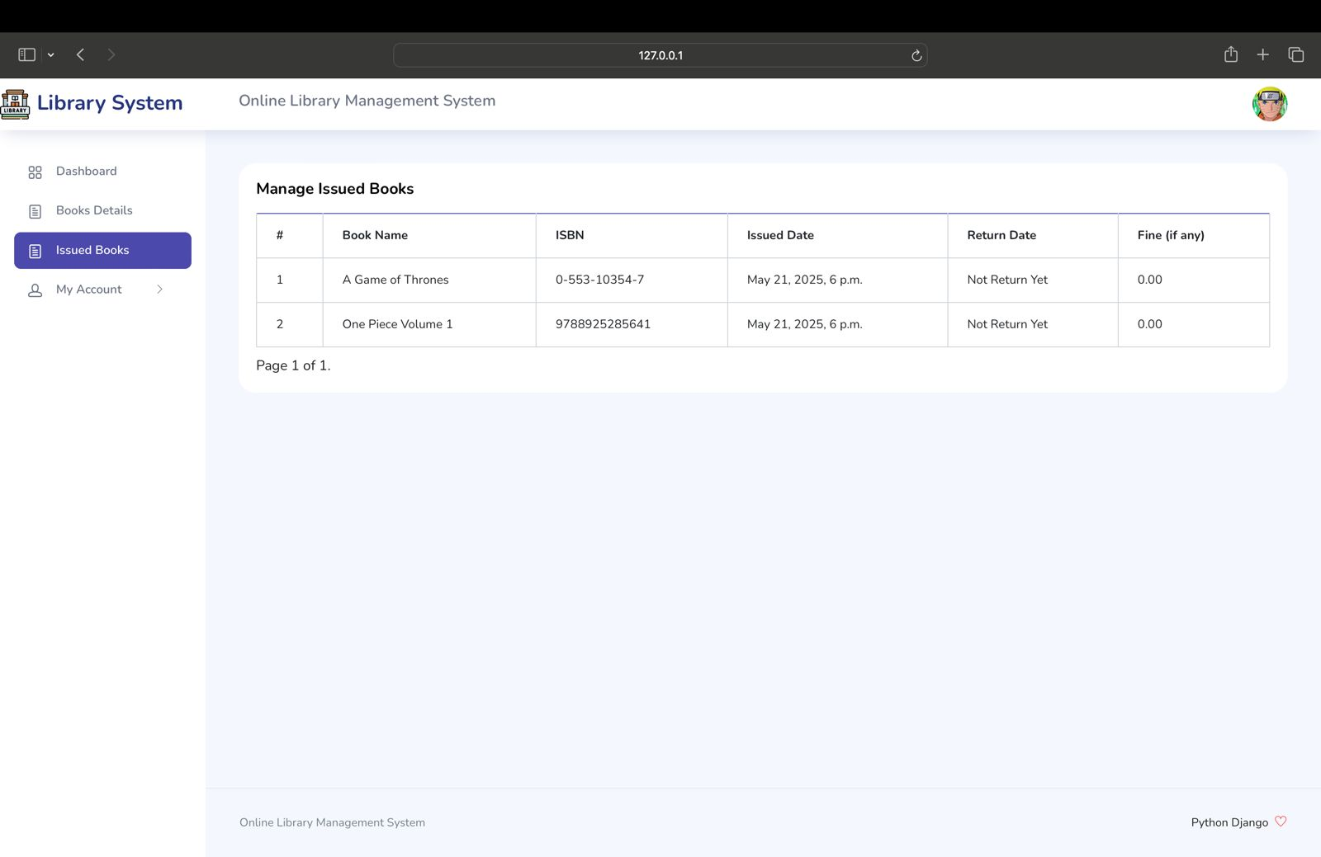
Module 4 - Admin Panel
After successful login admin can keep track of the books issued
It can also track which book is issued by the student
The number of copies of book which can help the librarian to know which book to order.

Slide 7
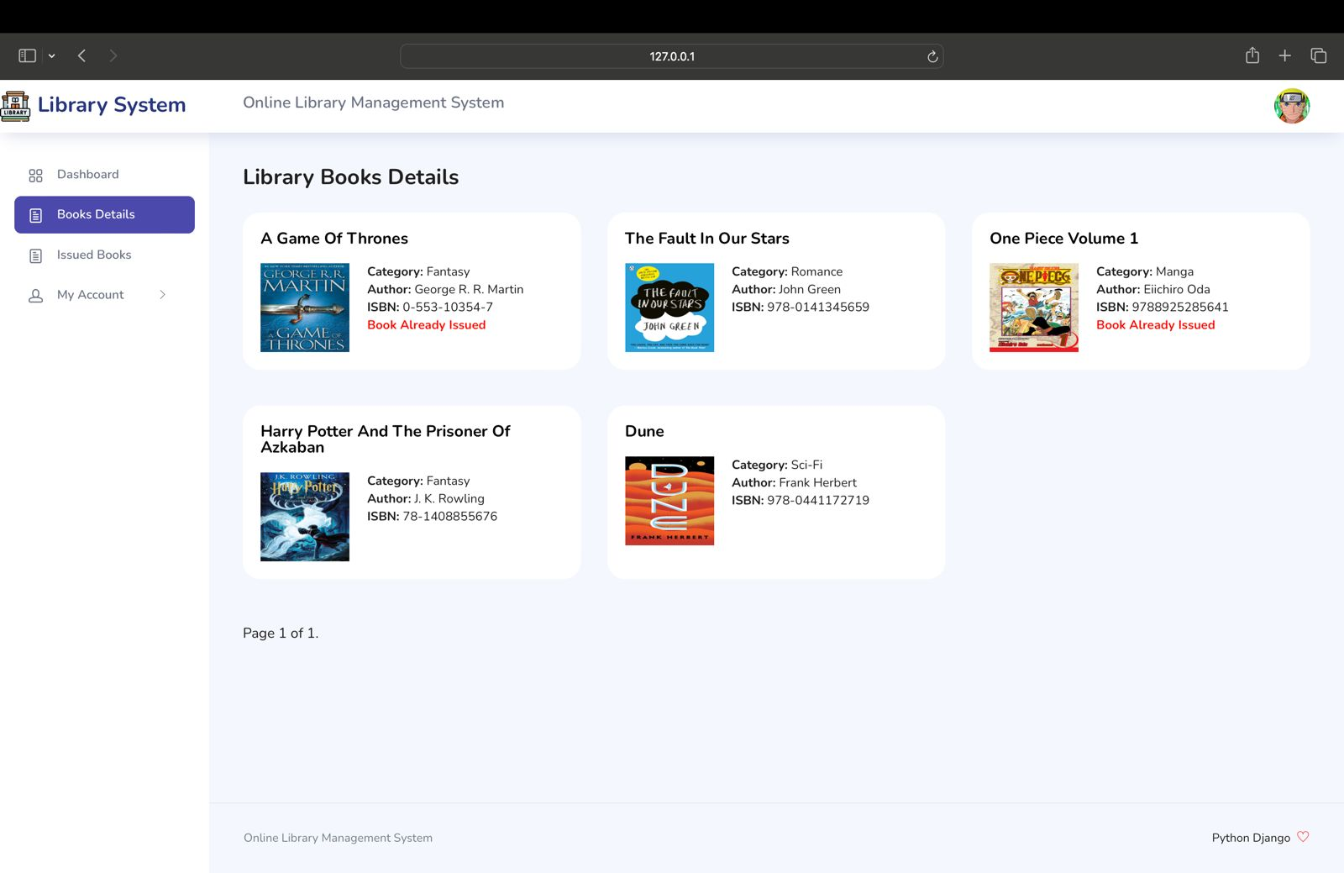
Module 5 – Book Search
Books present in the library can be searched.
The books can be searched on various parameters such as:
Category wise Search- If a student wants a book on Science - Fiction then system will show all the books related to Sci-Fi present in the library .
Author Wise Search- Can search a book on particular author. The system will show all the books on that author available in the library
ISBN Number Search- Searching a book based on particular edition will be available.

Slide 8
Technology Stack
Backend Technologies:
Language: Python 3.13
Framework: Django (Web Framework)
Database: MySQL
ORM: Django ORM
Frontend Technologies:
Markup: HTML 5
Styling: CSS3 Bootstrap
Scripting: JavaScript
Frontend Technologies:
IDE: PyCharm
Styling: CSS3 Bootstrap
Database Tool: MySQL Workbench

Slide 9
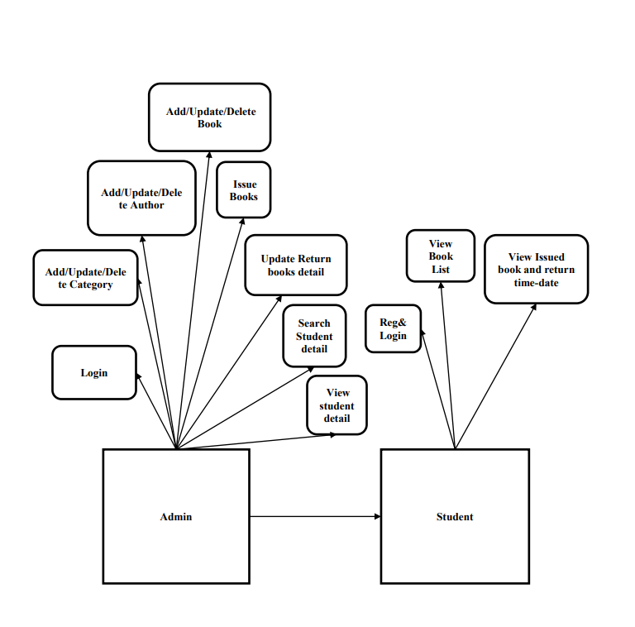
ER Diagram
Key Entities:
CustomUser (Authentication)
Student (Student profiles)
Book (Library books)
Author (Book authors)
Category (Book categories)
IssuedBookDetails (Transaction tracking)

Slide 10
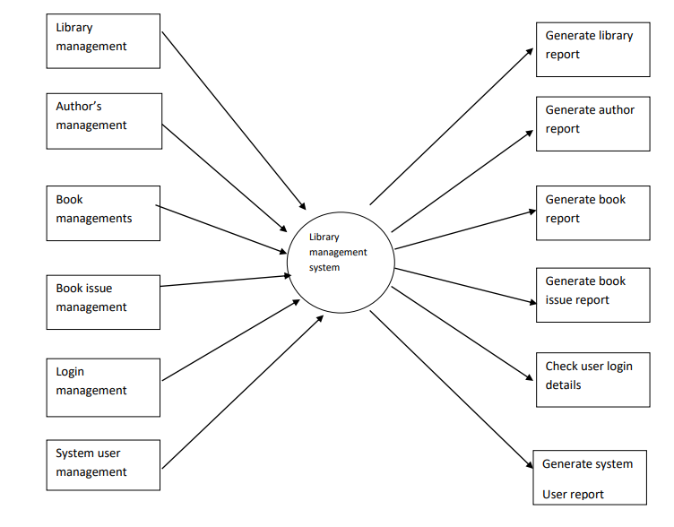
Data Flow Diagram
Data Flow Levels:
Level 0: Context diagram
Level 1: Detailed process flow
Shows data movement between users, system, and database

Slide 11
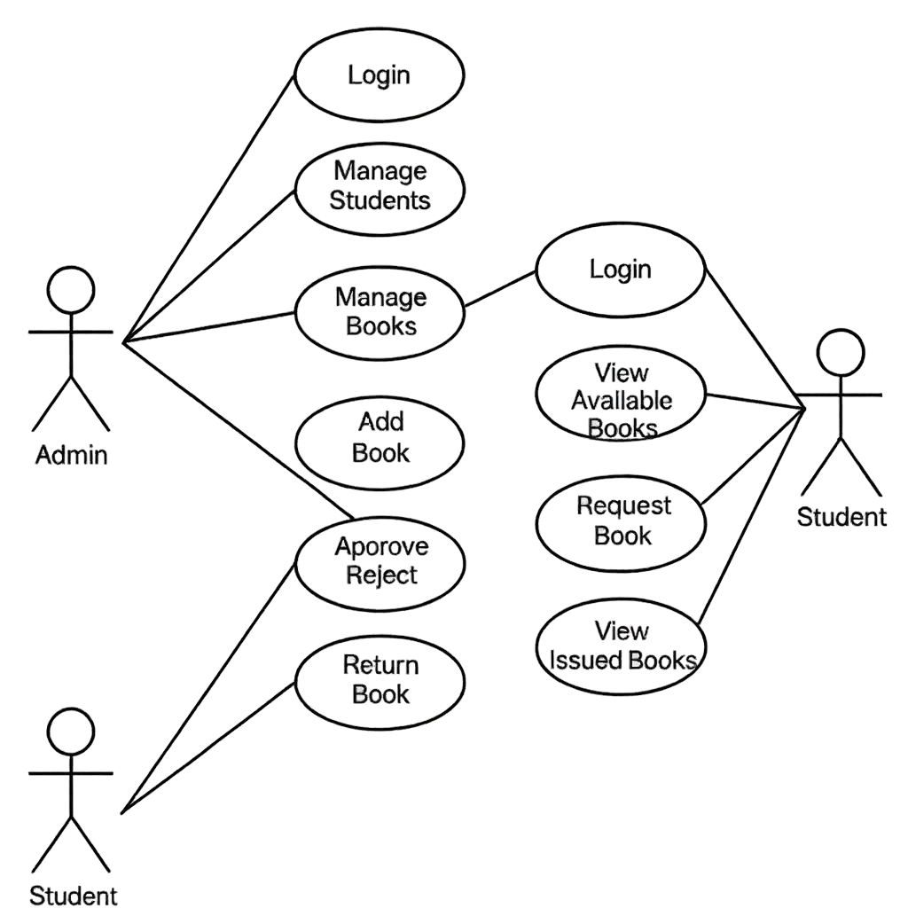
Use Case Diagram
Actors:
Admin: Full system control
Student: Book browsing and management
Key Use Cases:
User authentication
Book CRUD operations
Issue/Return management
Profile management

Slide 12
Testing Strategy
Testing Types Performed:
Unit Testing: Individual module testing
Integration Testing: Module interaction testing
System Testing: End-to-end functionality
User Acceptance Testing: Real user feedback
Key Test Cases:
Login authentication (Admin/Student)
Book CRUD operations
Issue/Return workflows
Data validation and security

Slide 13
FUTURE ENHANCEMENT
Automated fine calculation system
Email/SMS notification integration.
Mobile-responsive design.
Advanced search and filters.
Mobile app development.
AI-powered book recommendations.

Slide 14
Conclusion
Project Success:
Successfully automated traditional library operations
Implemented secure, role-based web application
Created scalable foundation for future enhancements
Demonstrated practical application of academic knowledge
Key Achievements:
Fully functional library management system
User-friendly interface for both admins and students
Secure data management with proper validation
Comprehensive documentation and testing

Slide 15
Acknowledgments
Presented By
Special Thanks to:
Prof. Anil Patidar - Project Guide and Mentor
Dr. Rashmi Yadav - Head of Institute
Dr. Sanjay Dubey - Head of Department
SAGE University, - For providing resources and support
Akshat Gangrade — 22COA2BCA0087
akshat2215@gmail.com
Jeet Singh Bais — 22COA2BCA0039
jeetsinghbais@gmail.com
GitHub: https://github.com/R3DuX-7/OLMS.git

